Slide 1
Spectral Unmixing
Superpixel-Based Reweighted Low-Rank and Total Variation Sparse Unmixing for Hyperspectral Remote Sensing (IEEE ,2021)
Debesh Maheshwari

Slide 2
Title and Introduction
Title:
Superpixel-Based Reweighted Low-Rank and Total Variation Sparse Unmixing for Hyperspectral Remote Sensing
Introduction:
Hyperspectral imaging captures detailed spectral information across hundreds of bands.
Key challenge: mixed pixels due to limited spatial resolution.
Goal: Accurately unmix hyperspectral data into pure spectral signatures (endmembers) and their proportions (abundances).

Slide 3
Challenges and proposed solutions
Traditional spatial-regularization-based sparse unmixing algorithms are limited by less accurate spatial information.
A novel sparse unmixing algorithm named Superpixel-Based Reweighted Low-Rank and Total Variation (SUSRLR-TV) is introduced to address this limitation.
The goal is to obtain more reliable spatial information and enhance the performance of traditional approaches
The proposed approach uses superpixel segmentation to consider both spatial proximity and spectral similarity.
Superpixels group pixels that are spatially close and spectrally similar.
A low-rank constraint is enforced on the objective function.
Pixels within each superpixel have the same endmembers and similar abundance values, naturally satisfying the low-rank constraint.

Slide 4
Sparse Unmixing Methods for Hyperspectral Remote Sensing
Linear Mixture Model (LMM)
The Linear Mixture Model (LMM) assumes that a hyperspectral image (HSI) can be represented as a linear combination of several pure spectral signatures. For a pixel, this is expressed as:
y=Mx+n
y is the spectral signature vector of the mixed pixel.
M is the spectral signature matrix containing p endmembers.
x is the abundance vector indicating the proportion of each endmember.
n denotes additional noise or model error.
To make the model practical, the abundance non-negativity constraint (ANC) and the abundance sum-to-one constraint (ASC) are imposed, ensuring that all elements in the abundance vector are non-negative and their sum is one .

Slide 5
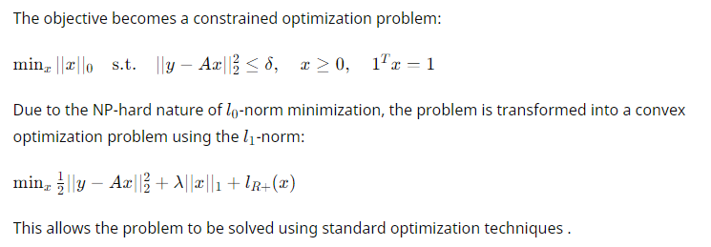
Sparse Unmixing
When using a standard spectral library as prior knowledge, the LMM extends to a sparse unmixing model:
y=Ax+n
A is the spectral library containing signatures for unmixing.
x is sparse, meaning it contains many zero values as only a few endmembers from the library participate in the mixed spectra.

Slide 6
SPARSE UNMIXING VIA SUSRLR-TV
SUSRLR-TV is proposed using more accurate spatial information and an effective constraint strategy.
Unlike traditional methods that only consider the positional relationship between pixels (i.e., the first-order domain, the local window).
The SUSRLR-TV method can acquire far more accurate spatial information by considering both spectral similarity and spatial neighborhood from the original hyperspectral image (HSI).
Adjacent pixels in an HSI tend to exhibit similar endmembers, except for pixels at the boundaries.
Similar spectra will also be derived from the same endmembers with similar abundances.

Slide 7
Procedure
In the first step, superpixels with semantic information are obtained by superpixel segmentation using the simple linear iterative clustering (SLIC) method.
The positional information of the pixels contained in these superpixels is then shared with the abundance matrix X
To implement a more efficient low-rank constraint, two strategies are used:
First, the abundance matrix of each superpixel is divided into several submatrices of the same size in columns.
Second, unlike the traditional convex approximation, the reweighted nuclear norm is used to approximate the rank.
TV regularization is also used to enhance the smoothness of the abundance map and the correlation of similar superpixel groups.

Slide 8
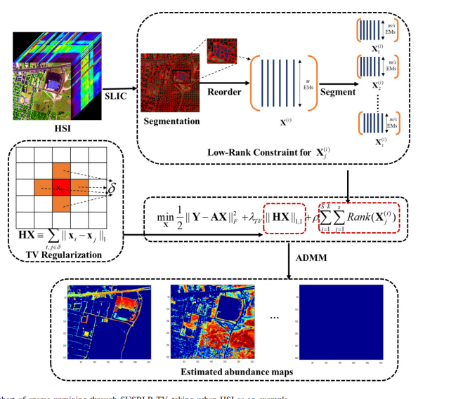
Flowchart

Slide 9
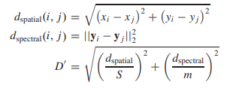
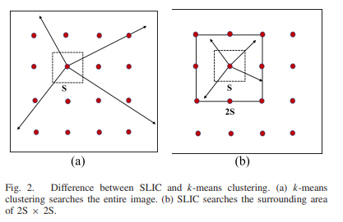
Homogeneous Regions Based on Superpixel Segmentation
Pixels within a homogeneous region are spatially compact and tend to exhibit similar reflection spectra.
These pixels may share the same endmembers and similar abundance values.
To obtain homogeneous regions, superpixel segmentation can be introduced.
Superpixel segmentation forms a series of regions containing unique semantic information (spatial information and spectral information).
A superpixel is a group of adjacent pixels with similar color, texture, and other characteristics.

Slide 10
Reweighted Low Rank constraint
The low-dimensional structure of the image is not well-maintained in traditional sparse unmixing approaches, and the contribution of the low-rank property is ignored.
In homogeneous regions, abundance vectors share the same endmembers and similar abundances.
Applying the low-rank constraint to the abundance matrix in each homogeneous region helps maintain the local low-dimensional structure, ensuring more detailed features of the abundance map are obtained.
The abundance matrix of each homogeneous region is divided into several submatrices by columns, enhancing the correlation of the active endmembers in each homogeneous region.

Slide 11
Conclusion
To verify the effectiveness and superiority of the proposed algorithm, three sets of simulated data, together with the well-known Cuprite data set, were used to compare different sparse unmixing algorithms.
The experimental results revealed that the proposed SUSRLR-TV algorithm outperforms the other algorithms both qualitatively and quantitatively, which further reveals that the use of efficient spatial information (considering both spectral similarity and spatial proximity) has a significant impact on the unmixing results.
Although the current performance is very encouraging, the complexity of the proposed algorithm is still a challenge for practical applications, and a more efficient optimization algorithm will be studied in our future research

Slide 12
Thank you

